Slide 1
Adiabatic Quantum Support Vector Machines
QCE23 Tutorial – 09/21/2023
In-Saeng Suh, Prasanna Date, Francisco Rios, Antonio Coello Perez, Kathleen Hamilton, Mayanka Chandra Shekar, John Gounley and Georgia Tourassi
Oak Ridge National Laboratory
Dong Jun Woun
University of Tennessee- Knoxville
This research is supported by the Department of Energy Office of Science Advanced Scientific Computing Research program office.

Slide 2
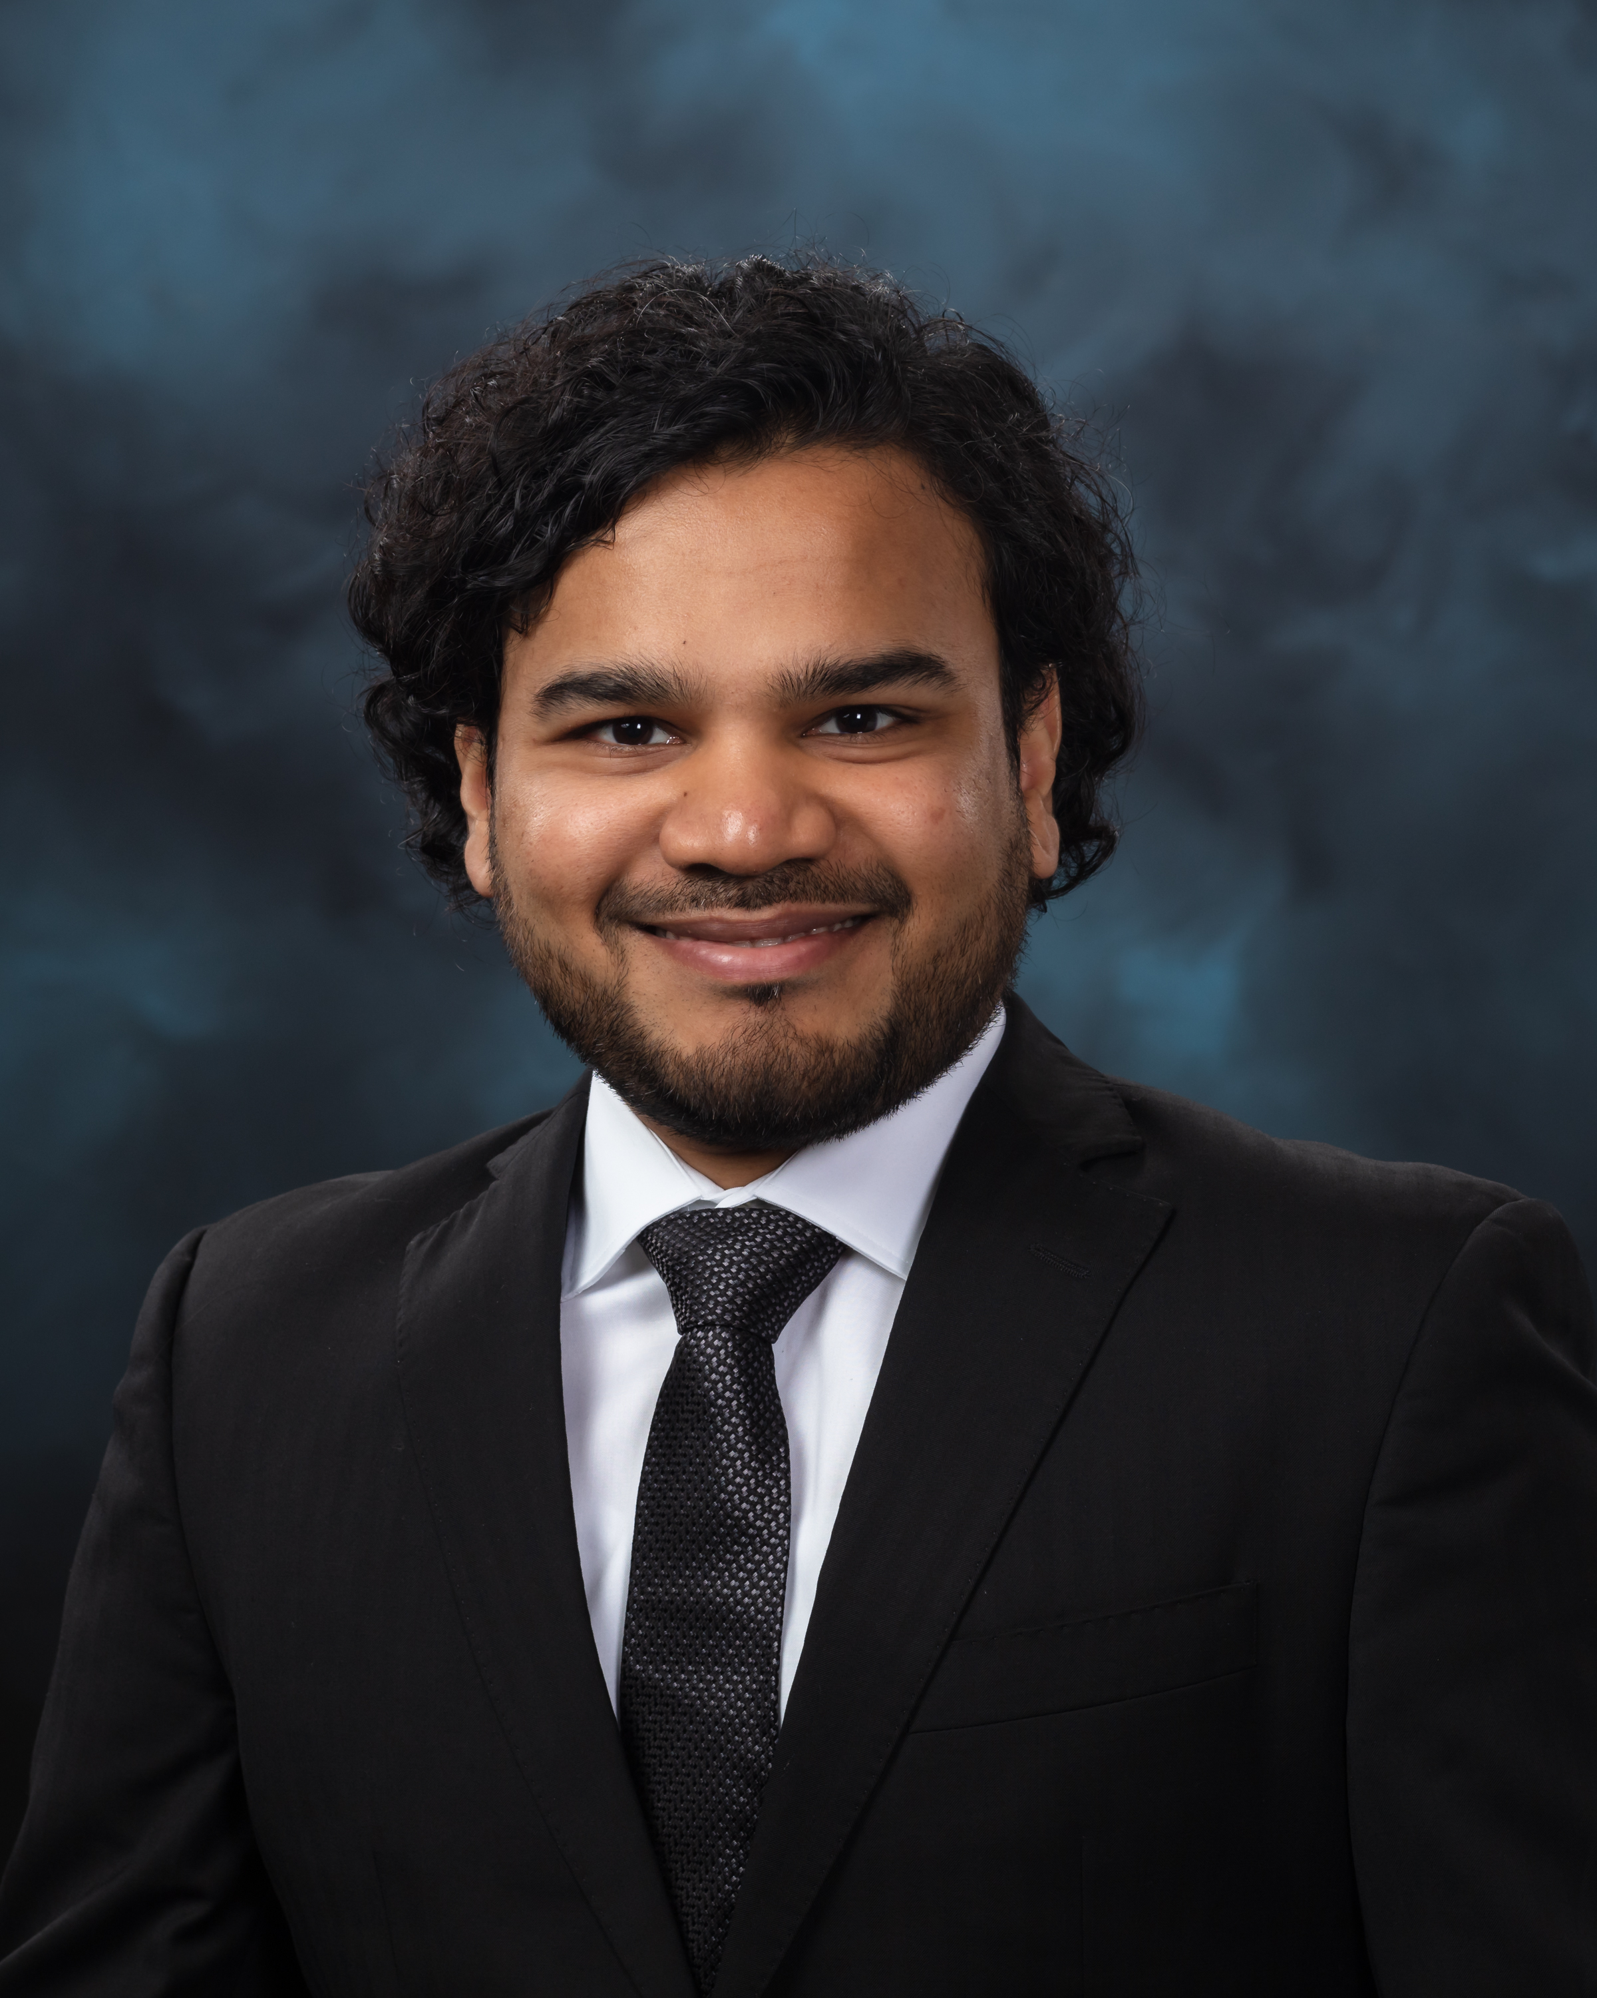
About Me
Research Scientist at ORNL (2019 - Present)
Education
Ph.D., M.S., M.Eng. from RPI, New York (2019)
B.Eng. from BITS Pilani, India (2014)
Featured on 2022 Forbes 30 Under 30 Asia list
2023 R&D 100 Award Winner
Associate Editor for IEEE TNNLS, Editorial Board Member for Nature Scientific Reports, Frontiers in Neuroscience, and Frontiers in Photonics
Research Interests: Neuromorphic AI, Quantum AI

Slide 3
Overview
Support Vector Machine
Why Quantum Computing?
Formulation for Adiabatic Quantum Computers

Slide 4
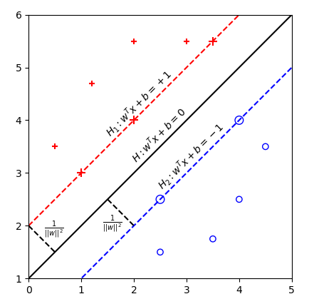
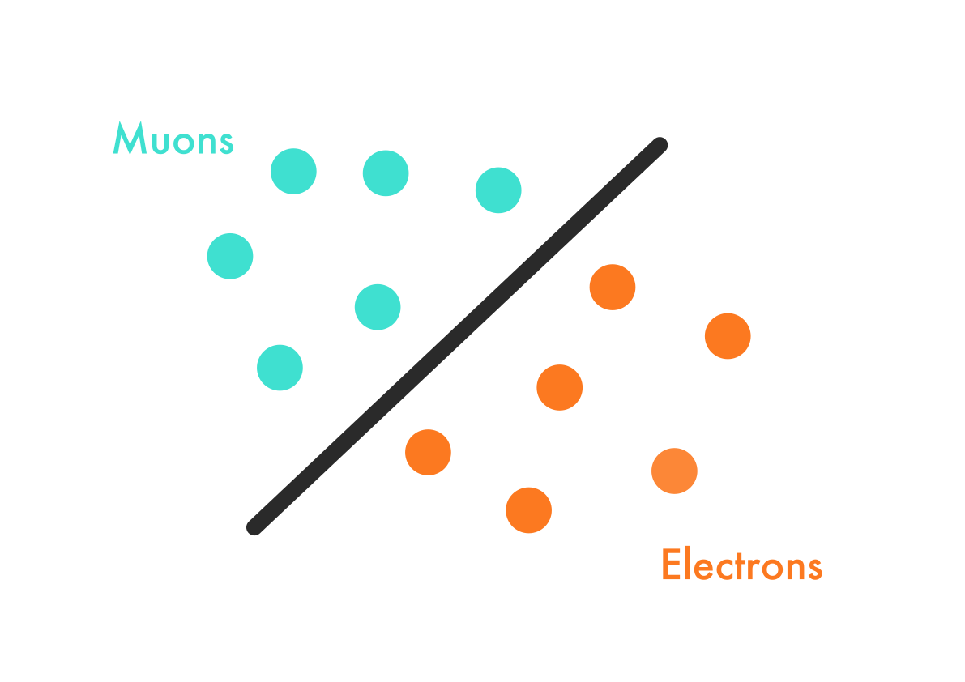
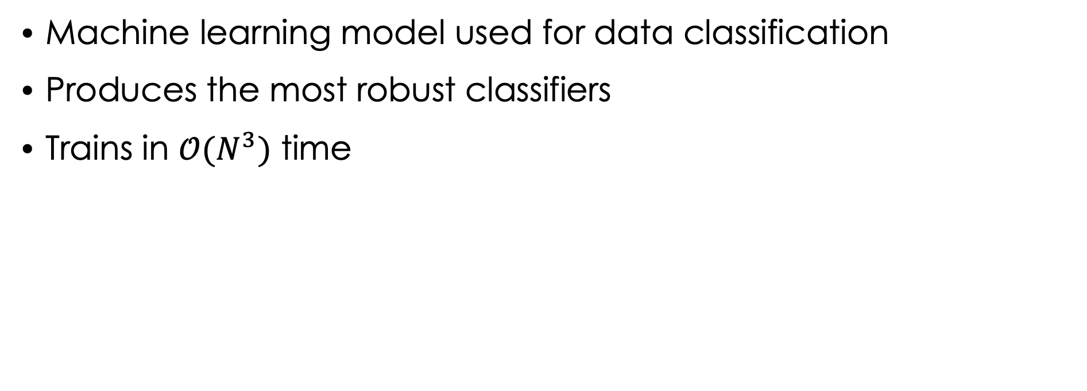
Support Vector Machine (SVM)
Machine learning model used for data classification
Produces the most robust classifiers
Trains in $𝒪(N^{3})$ time

Slide 5
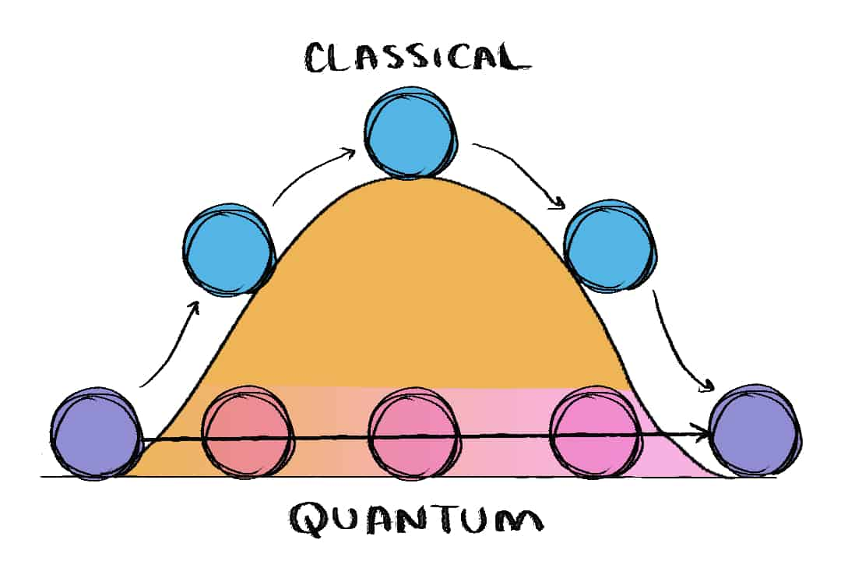
Why Quantum Computing?
Superposition, entanglement and tunneling
Exponentially faster than classical computers on certain problems
(Climb the hill)
(Tunnel through the hill)

Slide 6
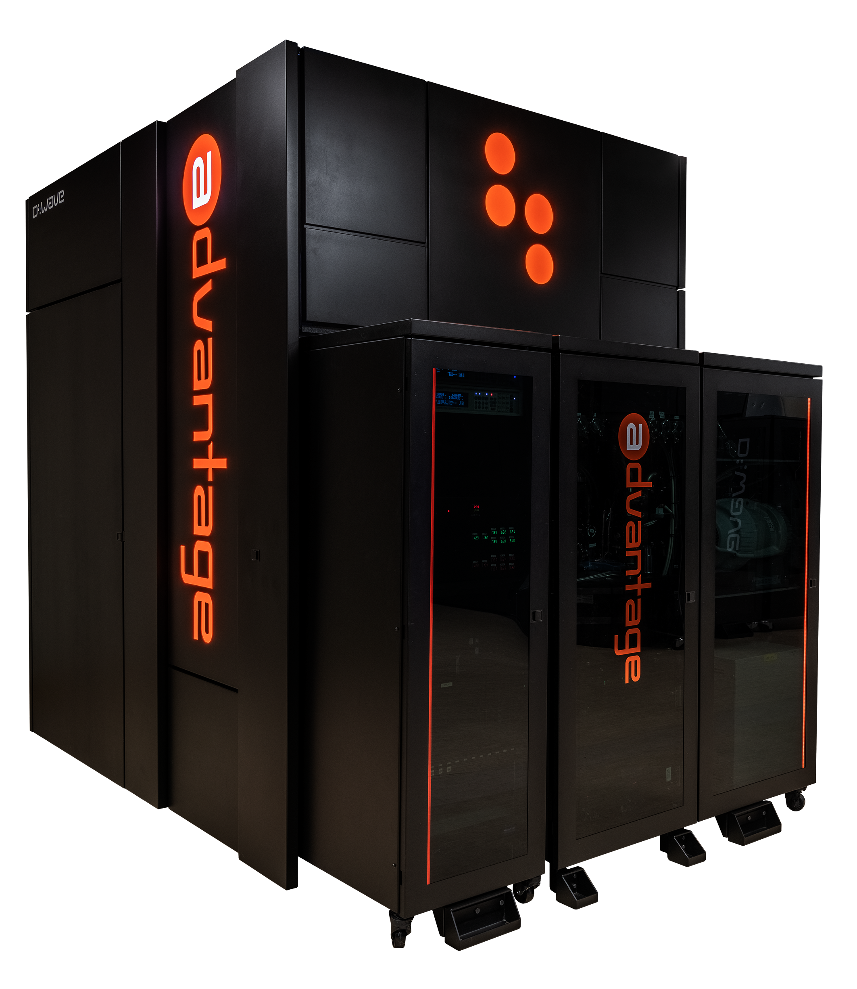
Why Adiabatic Quantum Computing?
Scalable in the near-term
Reasonably reliable performance
5000+ qubits
Solver for the quadratic unconstrained binary optimization (QUBO) problem
QUBO is NP-hard

Slide 7
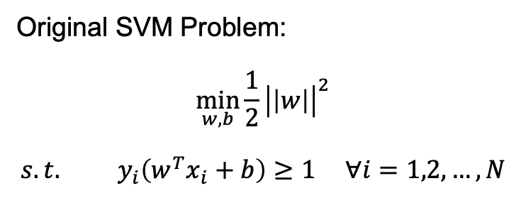
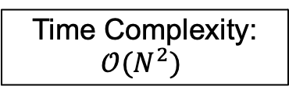
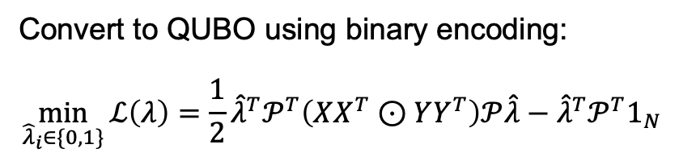
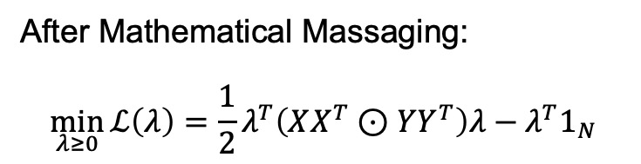
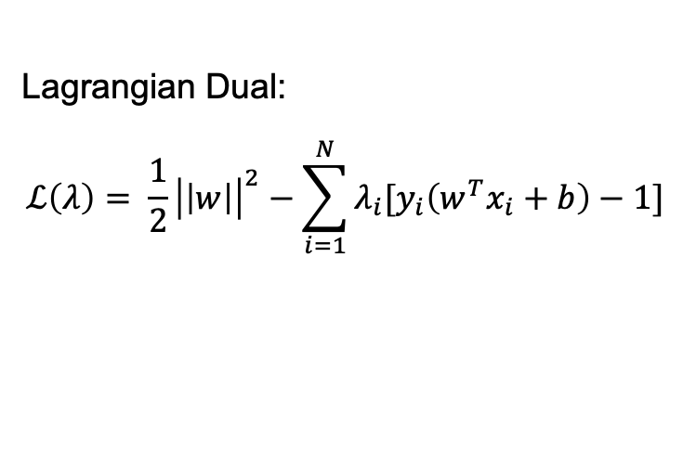
Formulation for Adiabatic Quantum Computers
Original SVM Problem:
$$\min_{w, b}{\frac{1}{2}}{\left|\left|w\right|\right|}^{2}$$
$$s.t. y_{i}\left(w^{T}x_{i}+b\right)≥1 ∀i=1,2,…,N$$
Time Complexity:
$$𝒪(N^{2})$$
Lagrangian Dual:
$$ℒ\left(λ\right)= \frac{1}{2}{\left|\left|w\right|\right|}^{2}−\sum_{i=1}^{N}{λ_{i}[y_{i}\left(w^{T}x_{i}+b\right)−1]}$$
After Mathematical Massaging:
$$\min_{λ≥0}{ℒ\left(λ\right)=\frac{1}{2}λ^{T}\left(XX^{T}⊙YY^{T}\right)λ−λ^{T}1_{N}}$$
Convert to QUBO using binary encoding:
$$\min_{{\hat{λ}}_{i}∈\{0,1\}}{ℒ\left(λ\right)=\frac{1}{2}{\hat{λ}}^{T}𝒫^{T}\left(XX^{T}⊙YY^{T}\right)𝒫\hat{λ}−{\hat{λ}}^{T}{𝒫^{T}1}_{N}}$$

Slide 8
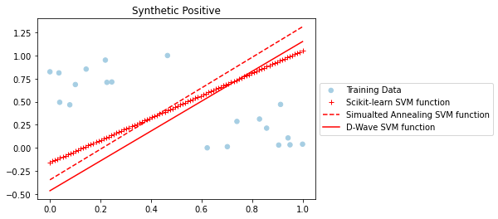
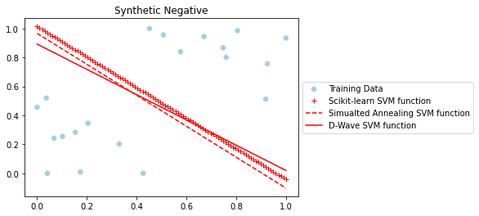
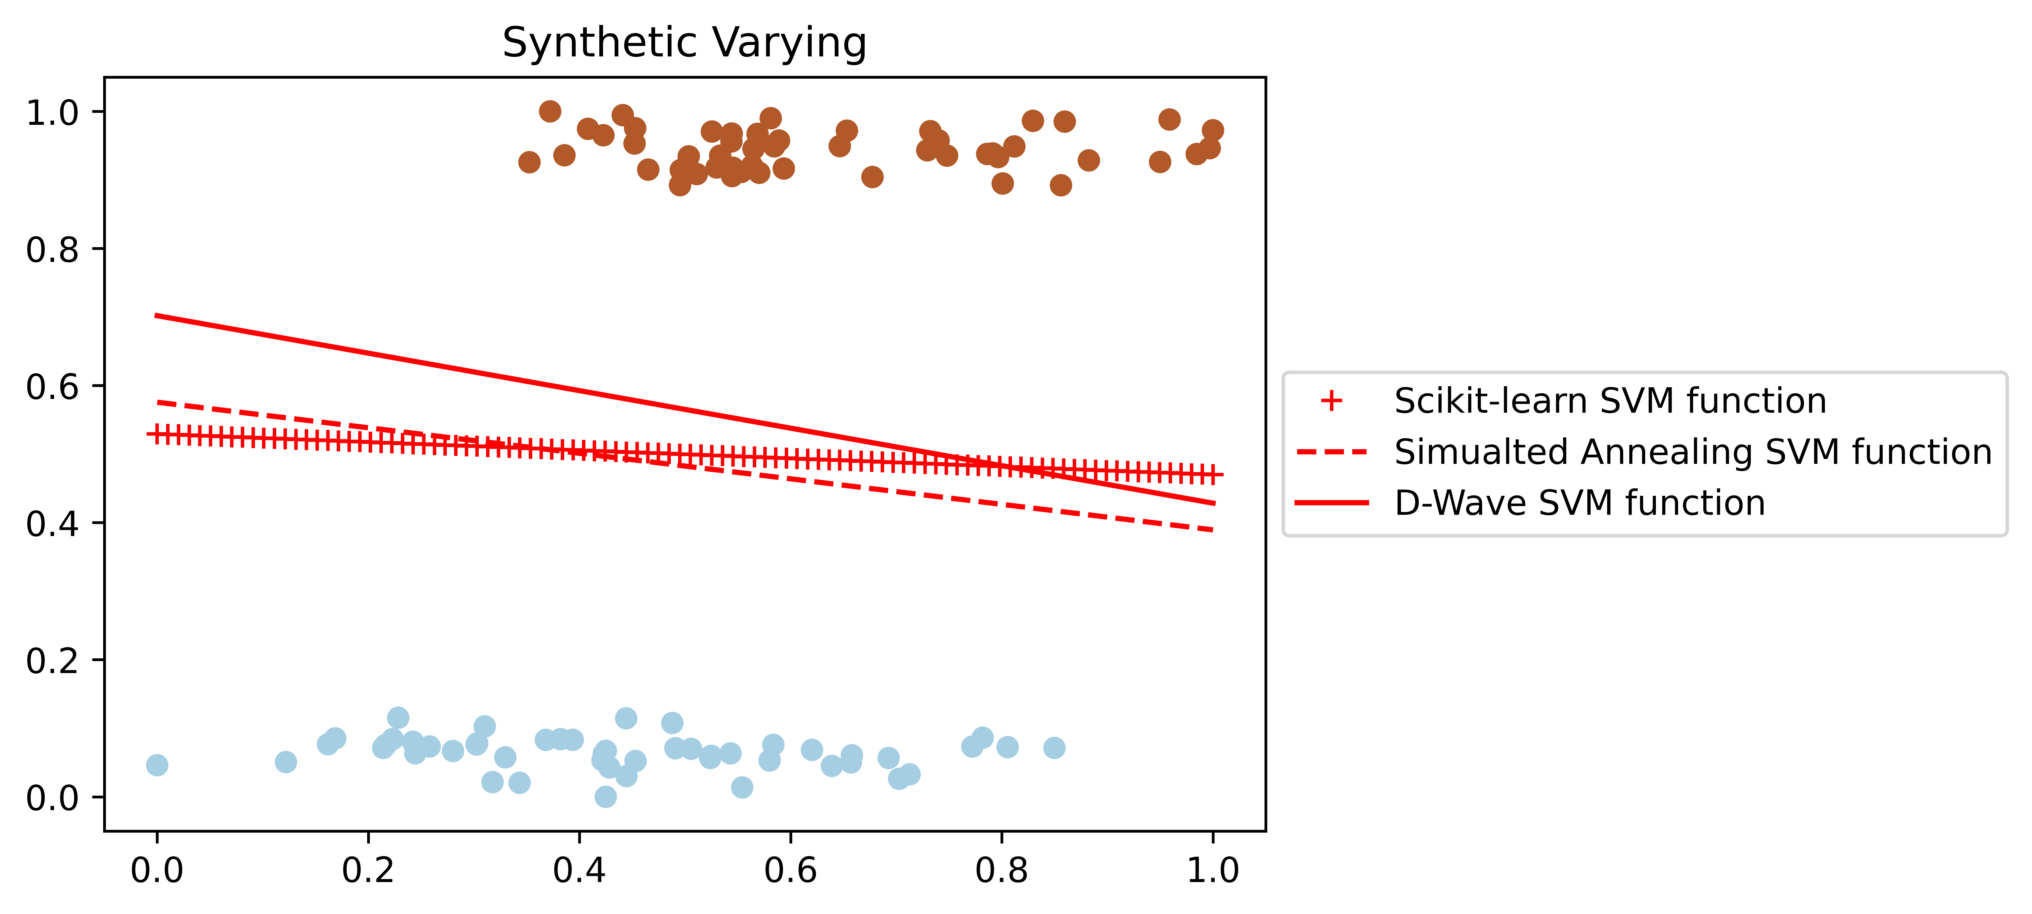
Results: Accuracy

Slide 9
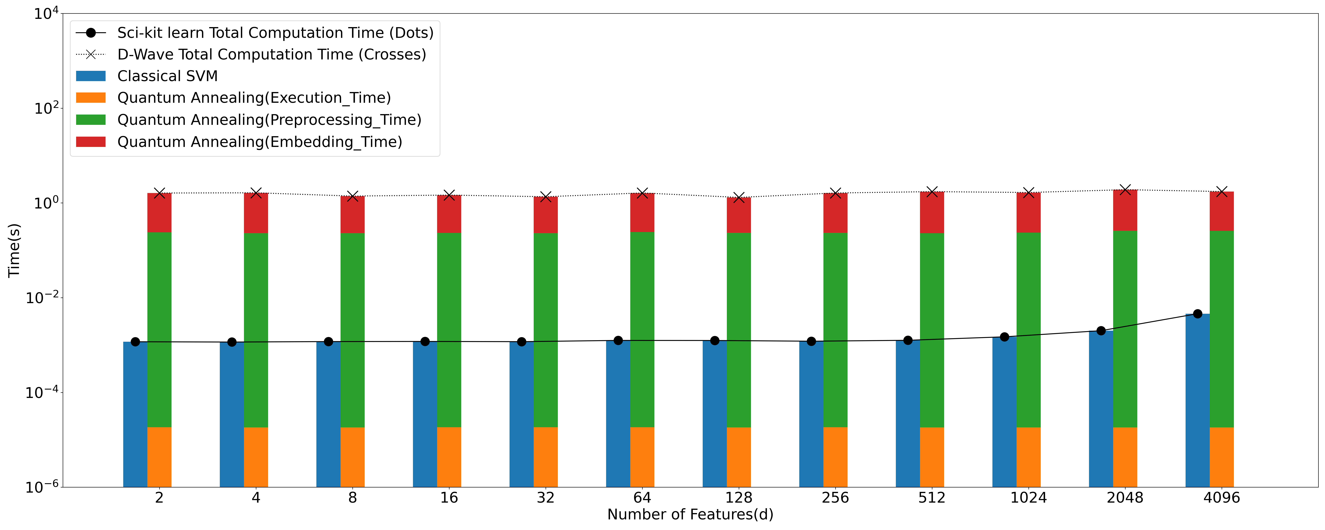
Results: Scalability with Number of Features

Slide 10
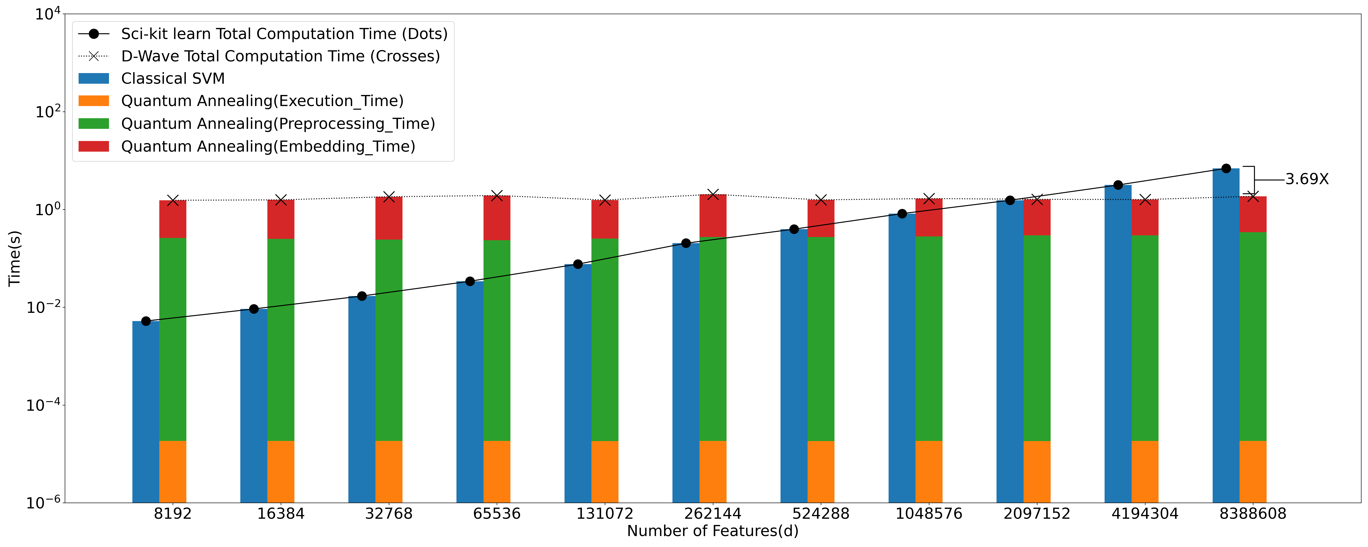
Scalability with Number of Features

Slide 11
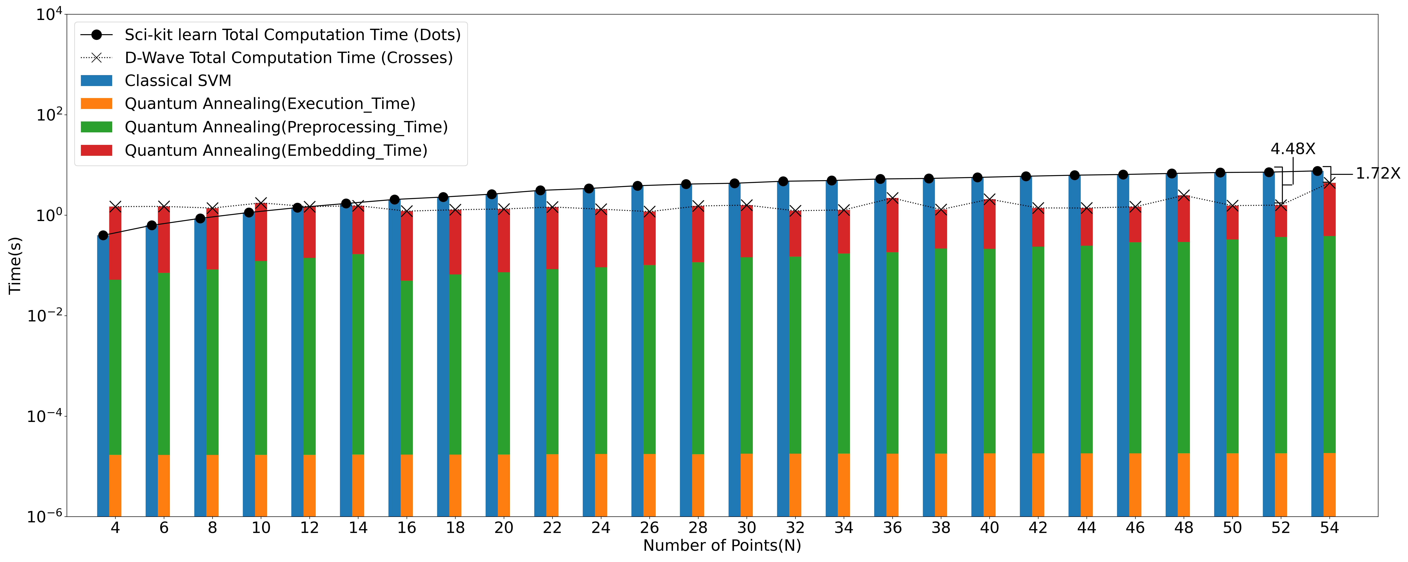
Scalability with Number of Data Points

Slide 12
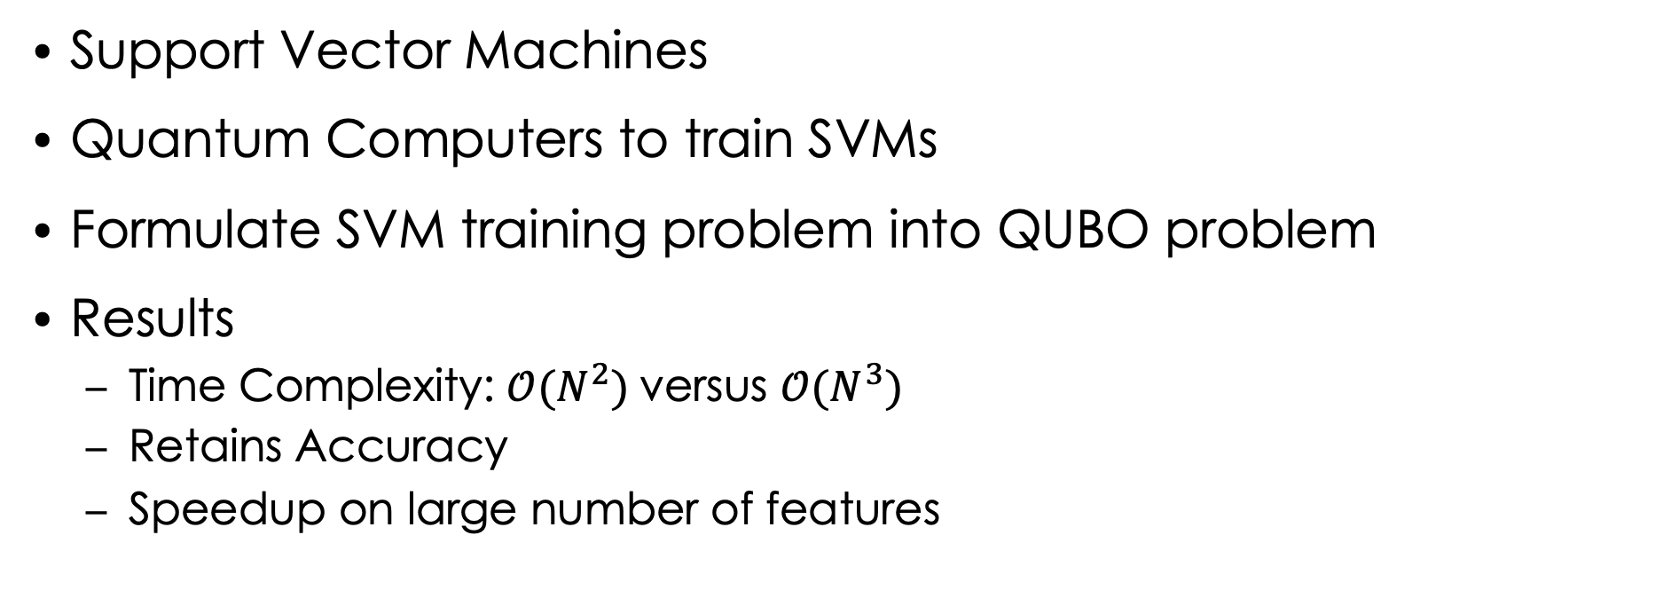
Summary
Support Vector Machines
Quantum Computers to train SVMs
Formulate SVM training problem into QUBO problem
Results
Time Complexity: $𝒪(N^{2})$versus $𝒪(N^{3})$
Retains Accuracy
Speedup on large number of features

Slide 13
Thank You!
QCE23 Tutorial – 09/21/2023
In-Saeng Suh, Prasanna Date, Francisco Rios, Antonio Coello Perez, Kathleen Hamilton, Mayanka Chandra Shekar, John Gounley and Georgia Tourassi
Oak Ridge National Laboratory
Dong Jun Woun
University of Tennessee- Knoxville
This research is supported by the Department of Energy Office of Science Advanced Scientific Computing Research program office.

